Slide 1

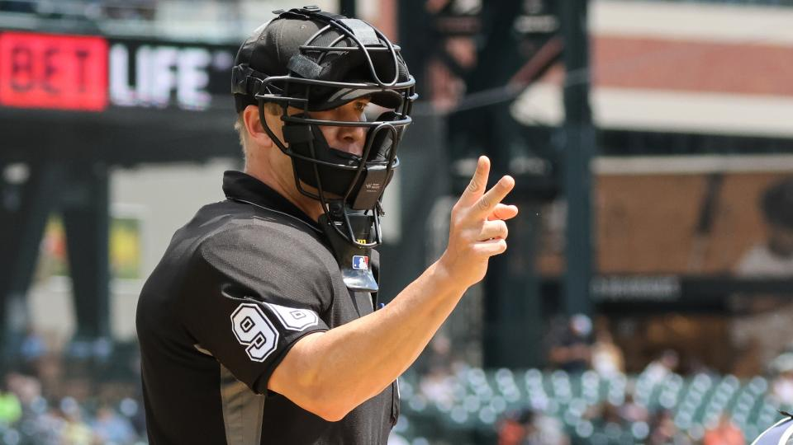
The Perfect Umpire: A Weighted Simulation of Alternate Realities
2023 SABR Diamond Dollars Case Competition
March 10, 2023
Rice University
Jeffrey Brover, Calvin Aberg, Jacob Hahn, Aya Nadalin, Rahul Prakash
Notes:
Good morning everyone thank you for your time today. My name is Rahul Prakash and we are the team representing Rice. Today we’ll be delivering our presentation that won our room at the 2023 SABR Analytics Conference where Ms. Gelles was one of our judges and we’ll be talking about the impact of incorrectly called ball and strikes on the final score of a few select games.

Slide 2

Table of Contents
1
Background
2
Methodology
3
Case Study 1: Doug Eddings 6/21/22
4
Case Study 2: Pat Hoberg 6/22/22
5
Summary and Analysis
Notes:
I’d first like to give a brief structure of our presentation today.

Slide 3

Section 1: Background
Notes:
Rahul

Slide 4
Problem Statement
With pitch tracking data, we have the ability to identify whether every pitch should be a ball or strike
RESULT: home plate umpires can be exposed for incorrect calls using the ABS
Average of 9.3 incorrect ball-strike calls per game in 2022
Must determine how incorrect calls impacted the final score in select games
Notes:
Rahul – pitch tracking data → verify whether pitch should be called a ball or strike → 9.3 → goal

Slide 5
Objectives
Understand the direct impact of changing the call of a given pitch on the final score of the game
Develop a methodology to account for the different realities that are created after each incorrectly called pitch is reversed
Notes:
Rahul
2 objectives
single call
multiple realities from reversing multiple calls

Slide 6
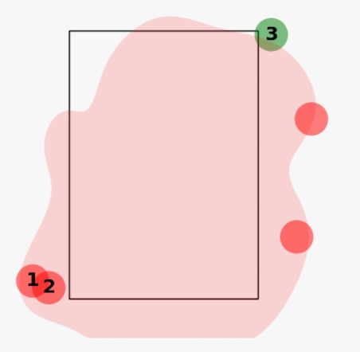
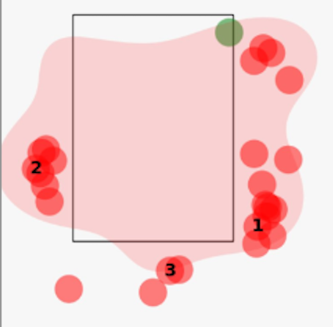
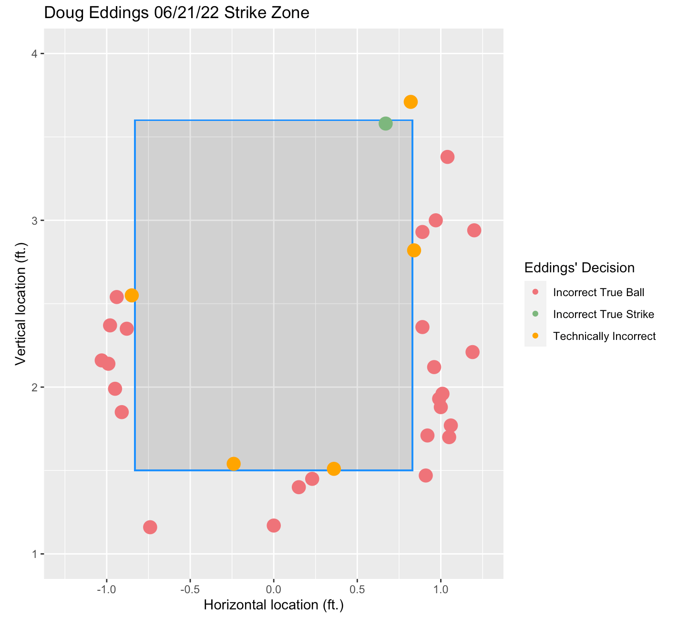
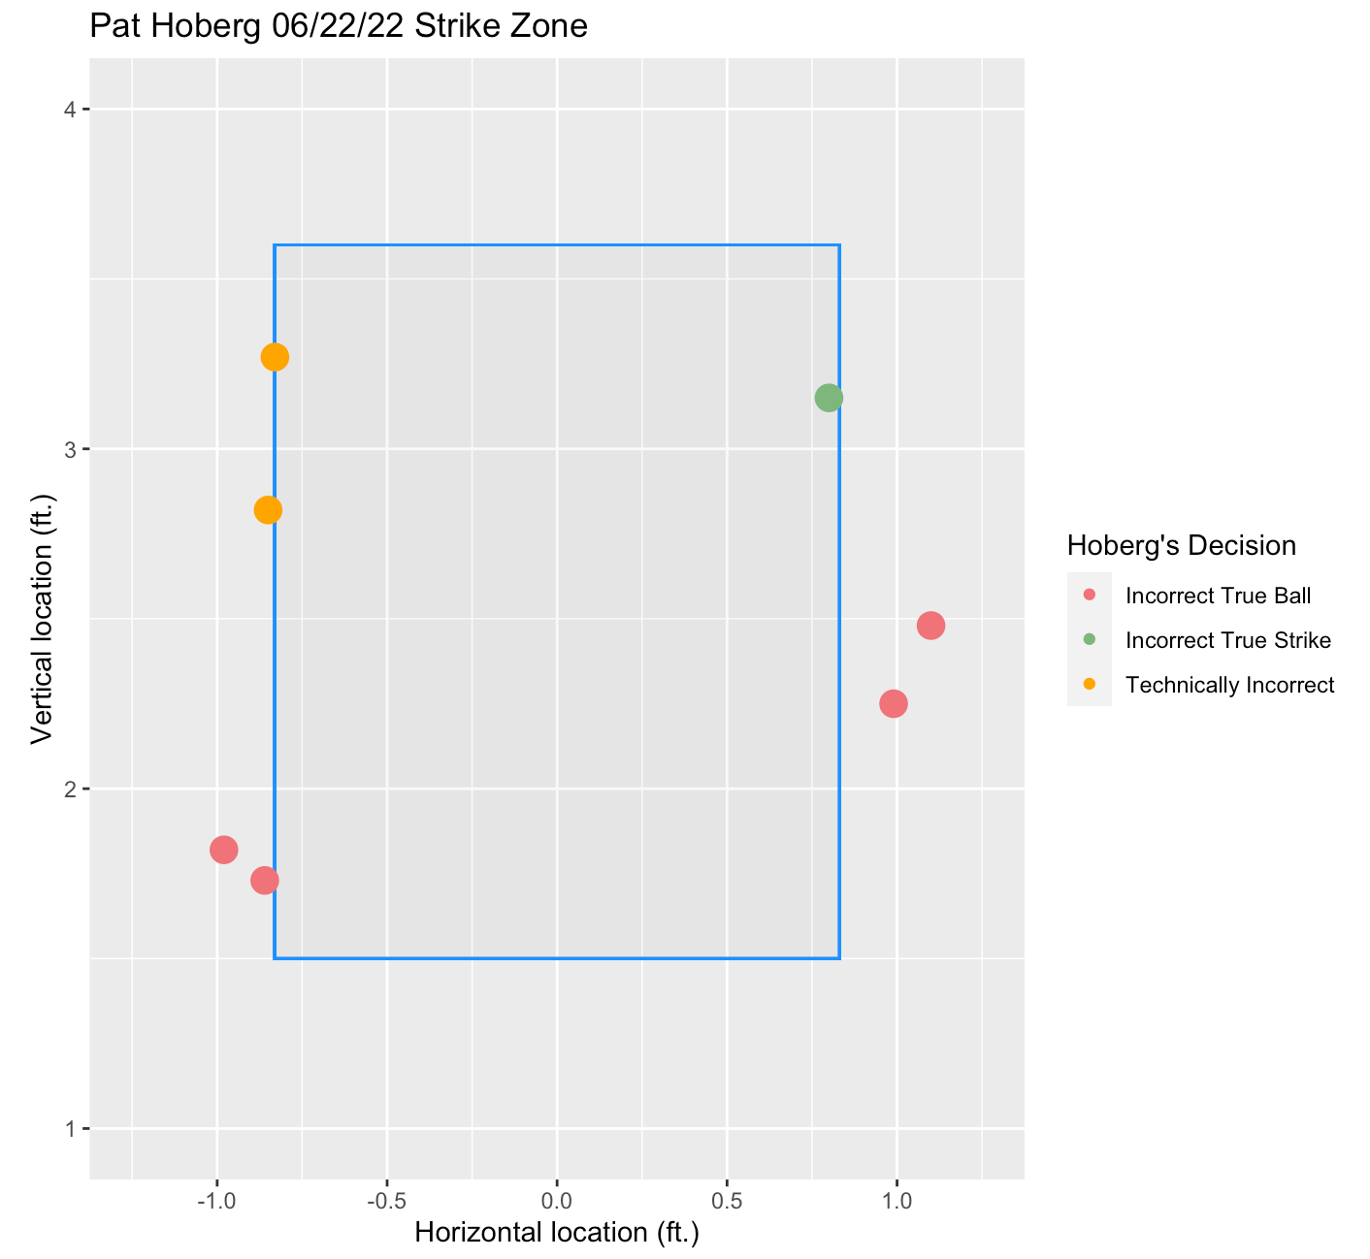
Identifying Incorrect Pitches
Notes:
Pat Hoberg called perfect game in game 2 of world series where the Astros won - name you might be familiar with

Slide 7
Section 2: Methodology

Slide 8
Overall Thought Process
Different approach than Ump Score Cards’ Run Expectancy
Treat each incorrect call as an alternate reality
Simulate game from starting point of each corrected call
Weight each call by a measure of importance
Produce an alternate final score from weighted values
Wrong Call 3
Wrong Call 4
Wrong Call 2
Alternate Reality 3
Alternate Reality 2
Wrong Call 1
Alternate Reality 1
Notes:
Jeff

Slide 9
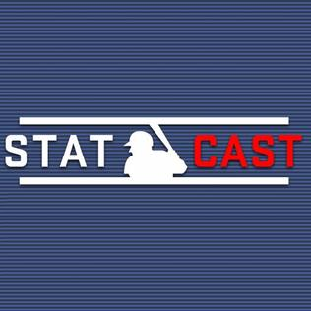
Step 1: Gather STATE and NEW STATE Values
Data: 708,539 Statcast Pitches from 2022
Create state based on runners, count, and outs
Utilize for pre-pitch and post-pitch values
Ex: 101222 → 000002 = 3 Run Home Run
{0,1} | {0,1} | {0,1} | {0,1,2,3} | {0,1,2} | {0,1,2}
Runner on 1st | Runner on 2nd | Runner on 3rd | Balls | Strikes | Outs
Notes:
Jeff

Slide 10
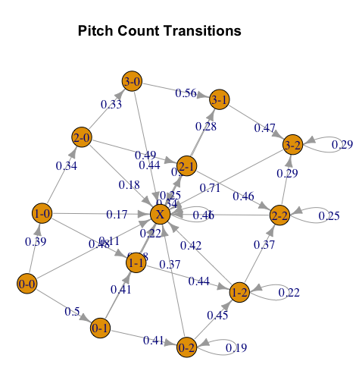
Step 2: Generate Transition Probability and Runs Matrix
Two main inputs of the simulation
Probabilities of moving from State Pre to State Post
Runs associated with moving from State Pre to State Post
Allow us to move through a baseball game
Ex: 2+2+1-0-2=3 for 3-Run Home Run
Runs = Runners^{(Pre)} + Outs^{(Pre)} + New_Batter - Runners^{(Post)} - Outs^{(Post)}
Notes:
Jeff

Slide 11
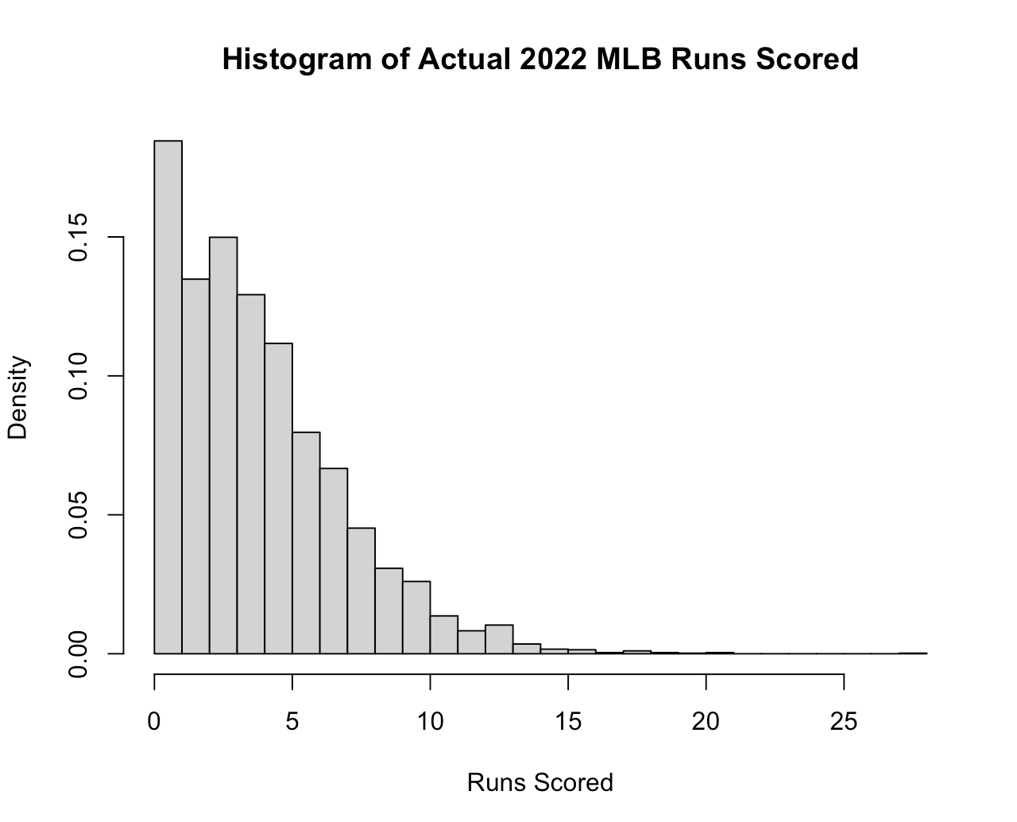
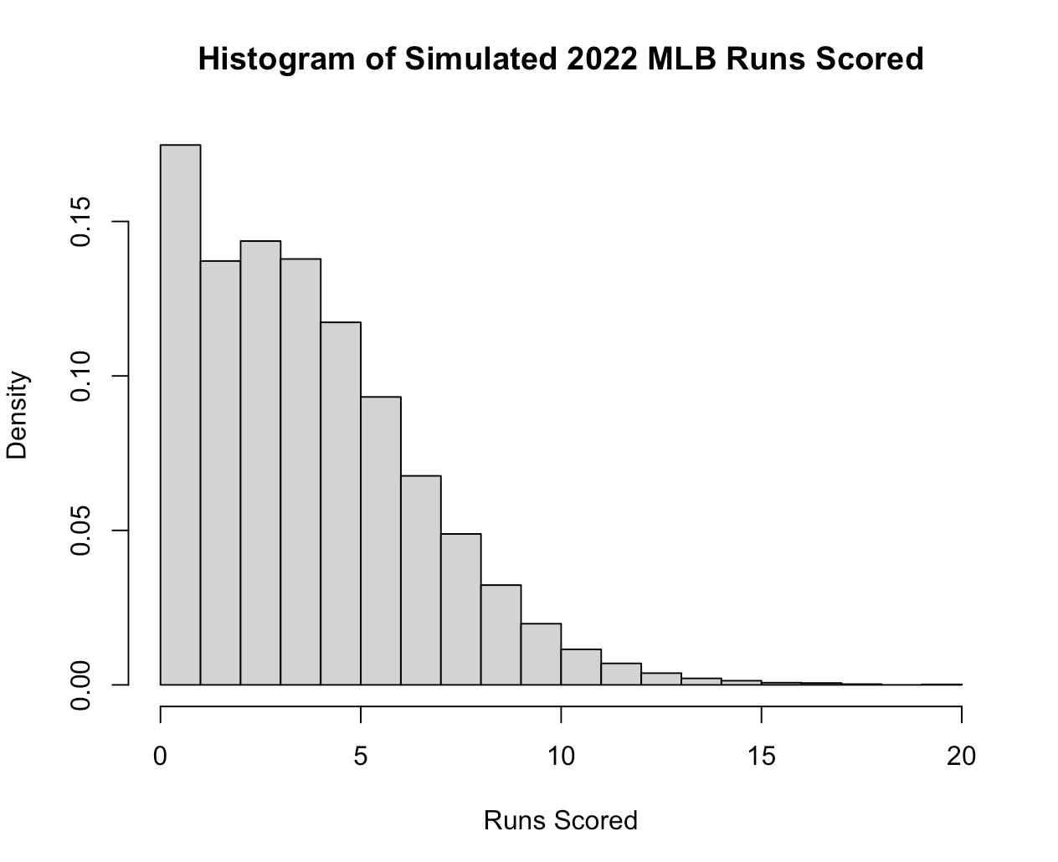
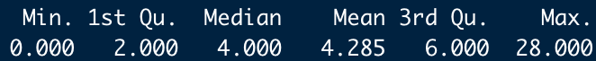
Step 3: Create Simulation Function
Main Inputs: Transition Probabilities Matrix, Runs Matrix
Optional Inputs: Starting State, Inning, Score
Process: Monte Carlo Simulation of a Baseball Game
Output: Final Score for 2 Teams
Notes:
Jeff

Slide 12
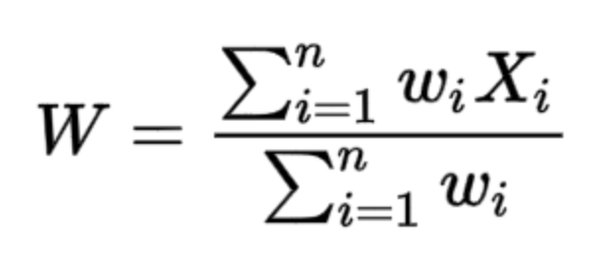
Step 4: Calculate Weights
Encompasses two factors: Amount of game remaining and odds of run scoring
Chose innings remainings and change in run expectancy
Multiplicative effect on each other
Weights = (Max(Innings) + 1 - Inning) x (∆RE))
Notes:
Jeff

Slide 13
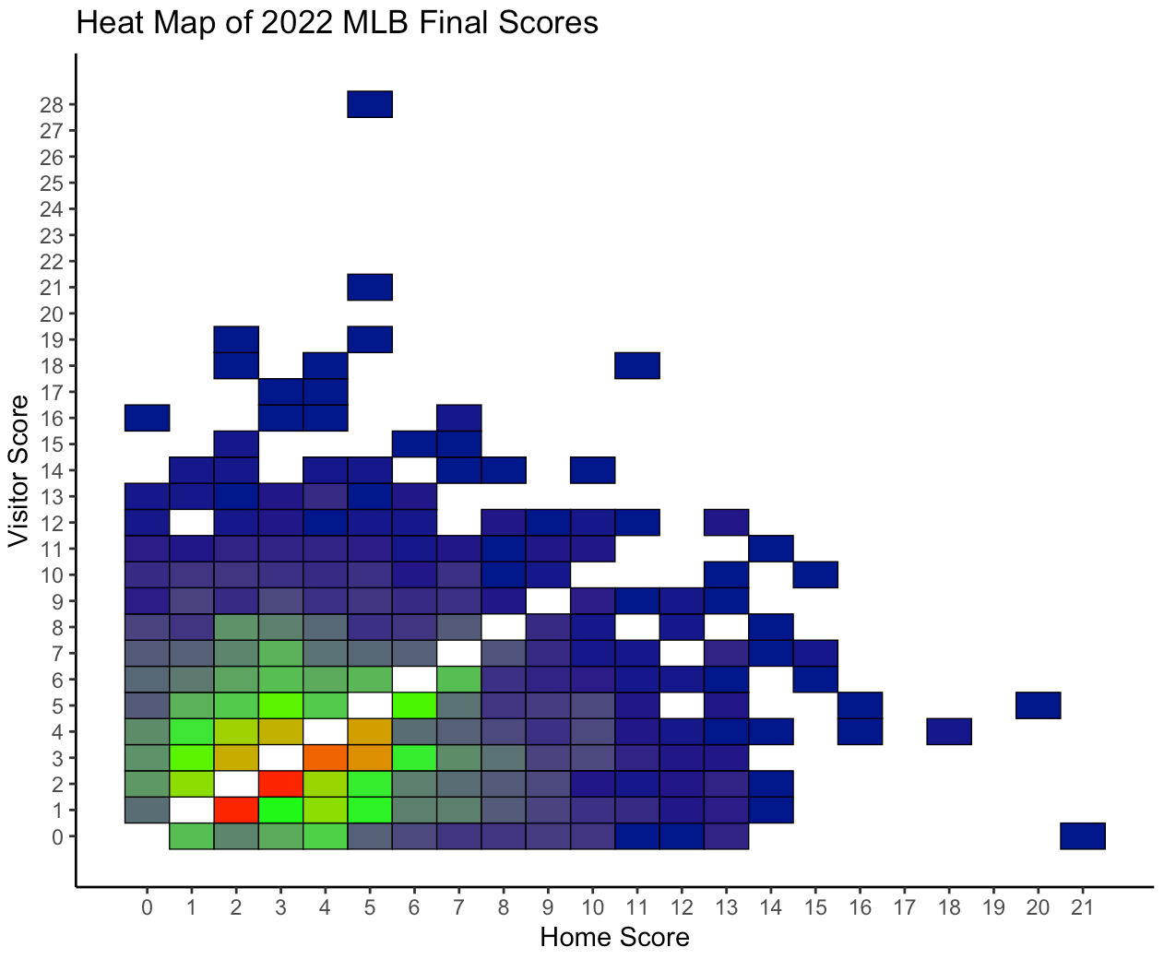
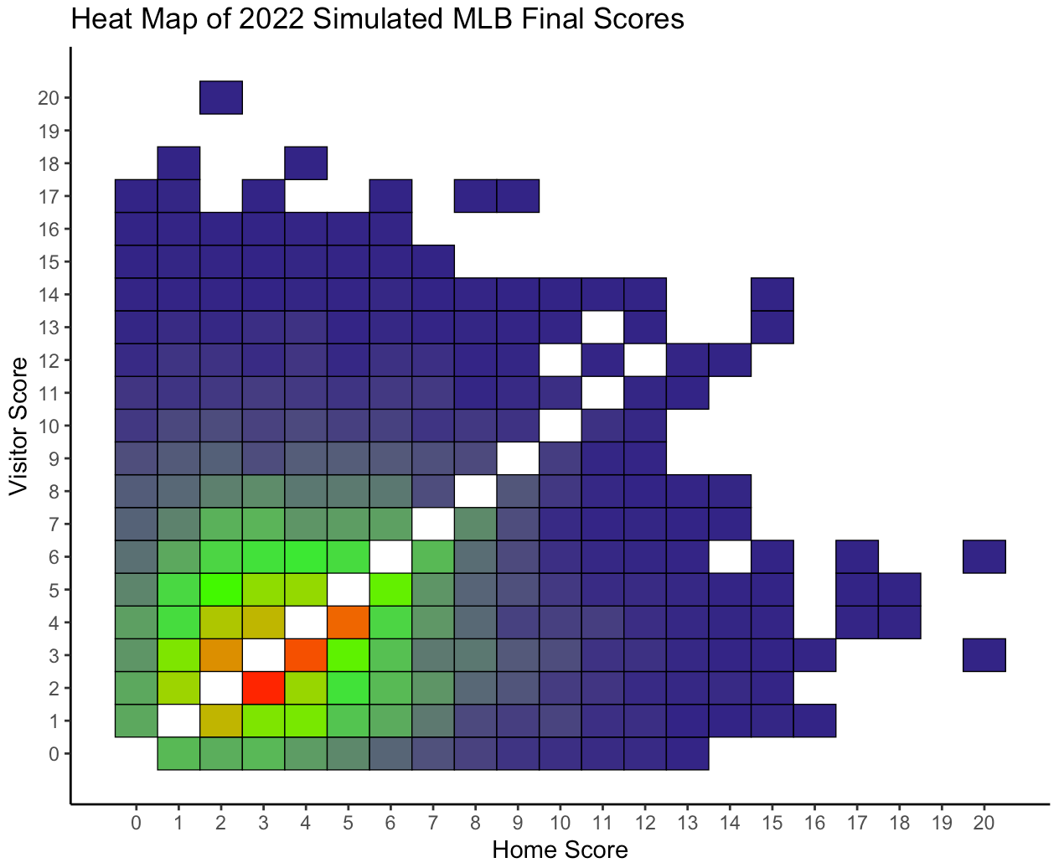
Step 5: Run For Two Real MLB Games
Apply to specific games in question
Simulate 10000 games for each incorrect call
Weight finals and produce score
Notes:
Jeff

Slide 14
Section 3: Doug Eddings 6/21/22

Slide 15
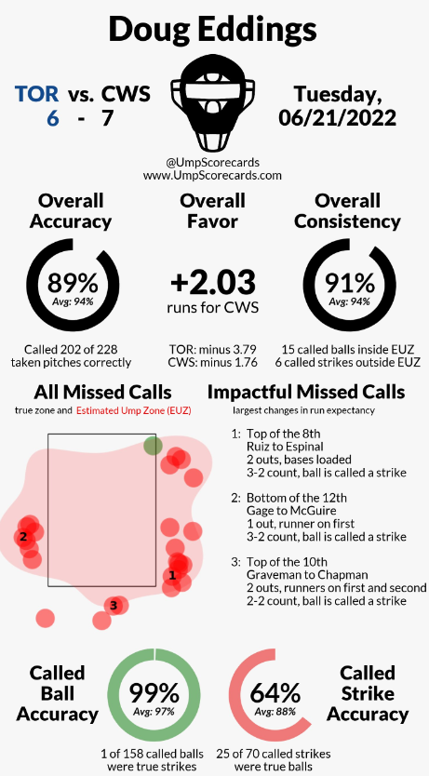
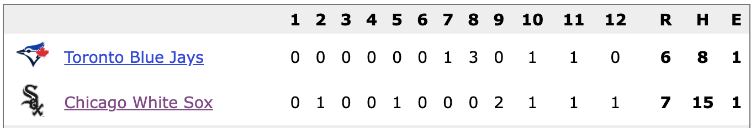
Game 1: Doug Eddings 06/21/22 (A)
26 missed calls
Slightly more concentrated early in game
Actual Score: Chicago 7-6 (12)
Game enters extra innings at 4-4
Alternative Final Score: Toronto 4-3
c
Notes:
Jacob

Slide 16
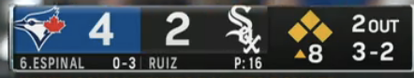
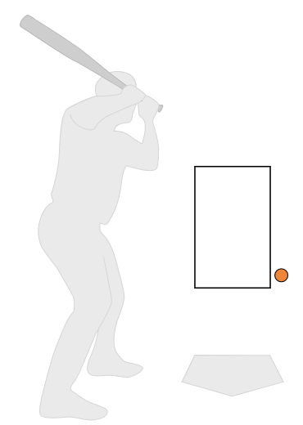
Eddings Play 1 - Call 19
Strike 3 - should have been called Ball 4
Change in Run Exp: -0.970
Mean Simulated Scores:
Toronto: 6.28
Chicago 2.98
Most Common Final Scores:
Toronto 5-2 (28.1% of sims)
Toronto 5-3 (10.6% of sims)
Toronto 6-2 (8.7% of sims)
Win Probability with Correct Call
Toronto: 93.2%
Notes:
Jacob

Slide 17
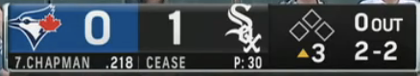
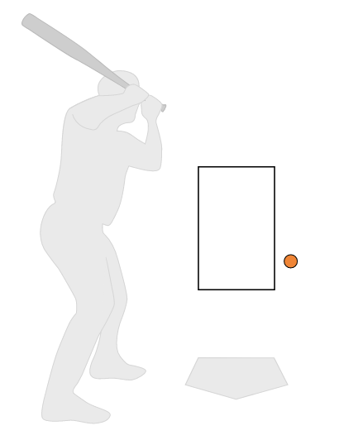
Eddings Play 2 - Call 5
Strike 3 - should have been called Ball 3
Change in Run Exp: -0.195
Mean Simulated Scores:
Toronto: 3.51
Chicago 4.10
Most Common Final Scores:
Chicago 3-2 (5.1% of sims)
Chicago 4-3 (4.2% of sims)
Chicago 2-1 (4.0% of sims)
Win Probability with Correct Call
Chicago: 60.9%
Notes:
Jacob

Slide 18
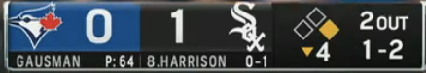
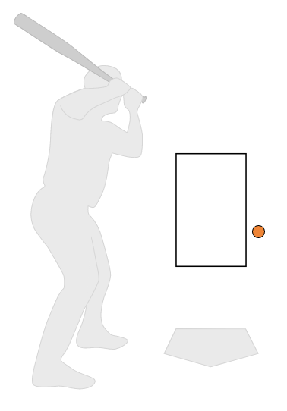
Eddings Play 3 - Call 10
Strike 3 - should have been called Ball 2
Change in Run Exp: -0.158
Mean Simulated Scores:
Toronto: 2.50
Chicago 3.37
Most Common Final Scores:
Chicago 2-1 (6.7% of sims)
Chicago 1-0 (6.1% of sims)
Chicago 3-2 (6.0% of sims)
Win Probability with Correct Call
Chicago: 66.8%
Notes:
Jacob

Slide 19
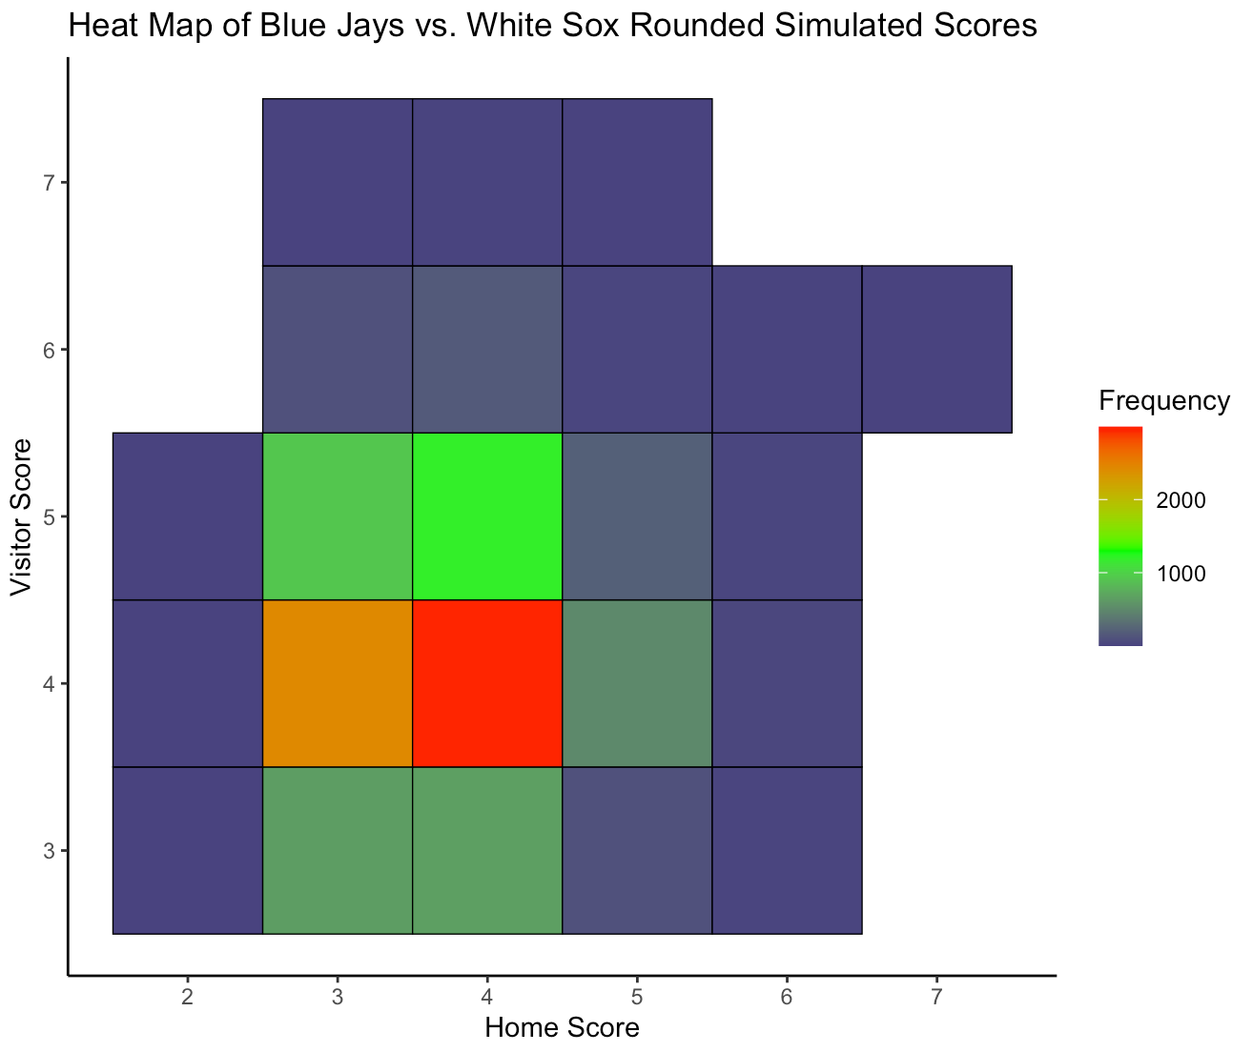
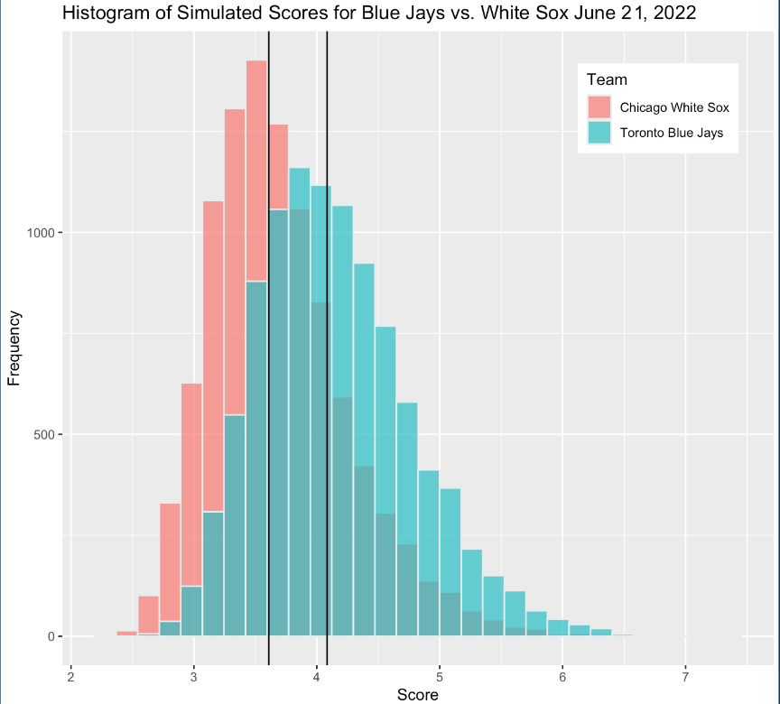
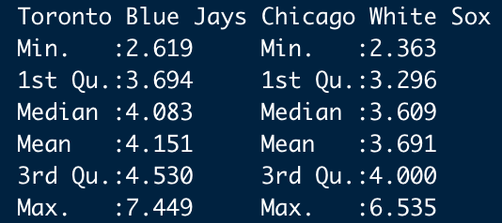
Eddings Results
Notes:
Jacob

Slide 20
Section 4: Pat Hoberg 6/22/22

Slide 21
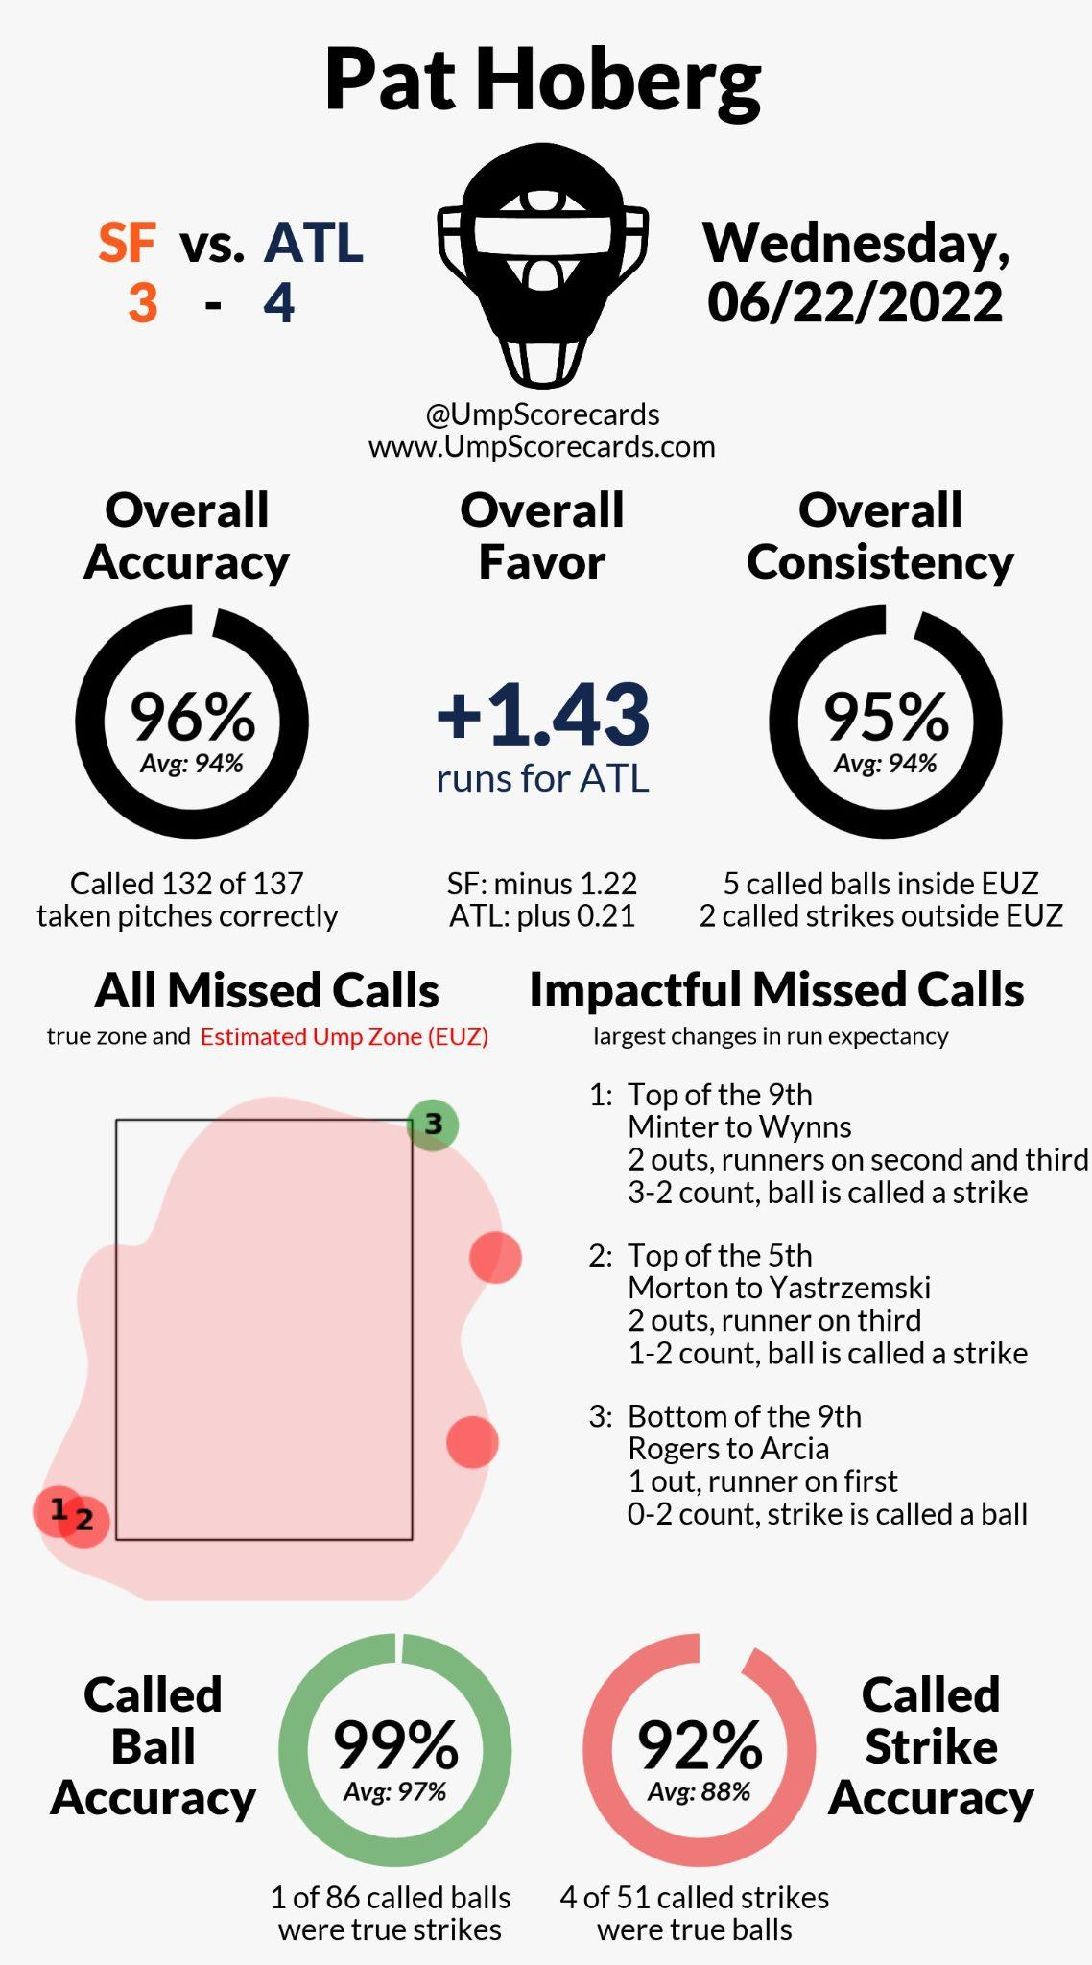
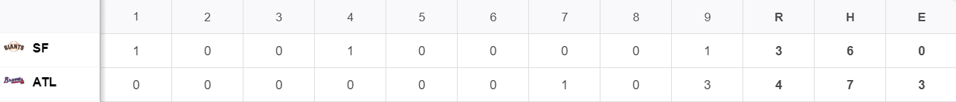
Game 2: Pat Hoberg 06/22/22 (Group B)
5 missed calls
All in favor of ATL
First call in 5th inning
Only one true strike called ball
Actual Score: Braves 4-3
Alternative Final Score: Giants 4-2
Notes:
Calvin

Slide 22
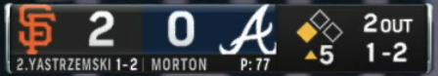
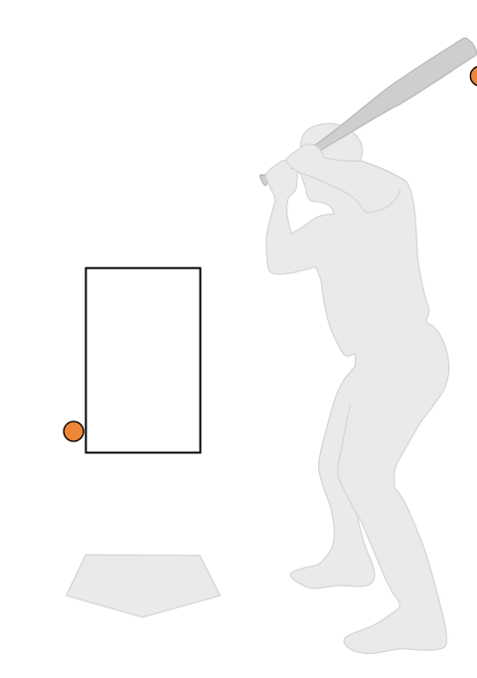
Hoberg Call 1
Strike 3, should have been ball 2
Weight importance rank: 1st
Change in run expectancy: -0.240
Mean Simulated Scores:
San Francisco: 4.2816
Atlanta: 2.3494
Most Common Final Scores:
Atlanta 3-2 (5.8% simulations)
San Francisco 3-0 (5.7% simulations)
San Francisco 2-0 (5.4% simulations)
Win probability with correct call:
San Francisco: 74.95%
Notes:
Calvin

Slide 23
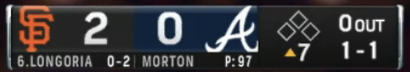
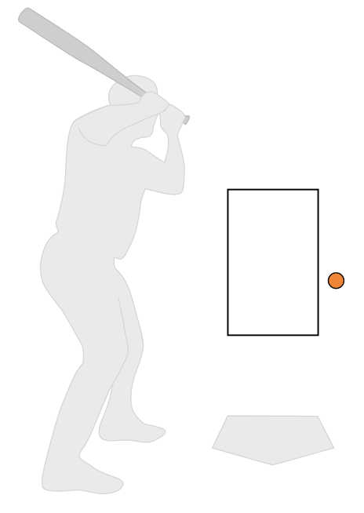
Hoberg Call 2
Strike 2, should have been ball 2
Weight importance rank: 3rd
Change in run expectancy: -0.054
Mean Simulated Scores:
San Francisco: 3.5626
Atlanta: 1.4379
Most Common Final Scores:
San Francisco 2-0 (16.4% simulations)
San Francisco 2-1 (9.7% simulations)
San Francisco 3-0 (6.4% simulations)
Win probability with correct call:
San Francisco: 83.0%
Notes:
Calvin

Slide 24
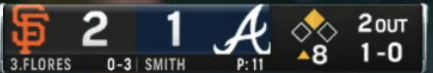
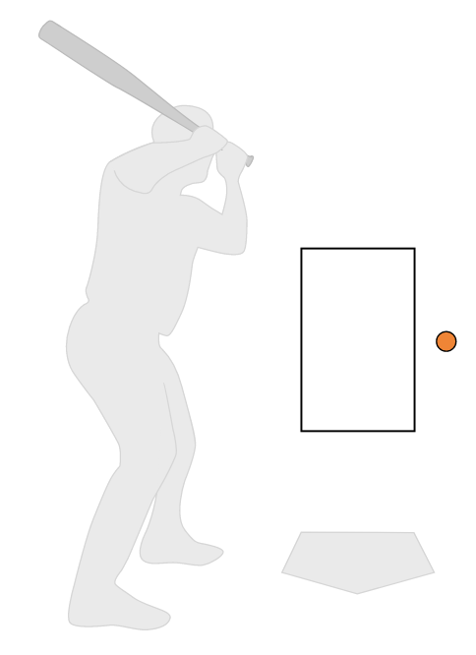
Hoberg Call 3
Strike 1, should have been ball 2
Weight importance rank: 4th
Change in run expectancy: -0.054
Mean Simulated Scores:
San Francisco: 3.0409
Atlanta: 2.0368
Most Common Final Scores:
San Francisco 2-1 (31.8% simulations)
Atlanta 3-2 (12.2% simulations)
San Francisco 3-1 (11.6% simulations)
Win probability with correct call:
San Francisco: 74.84%
Notes:
Calvin

Slide 25
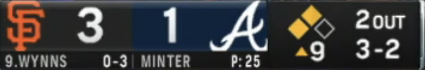
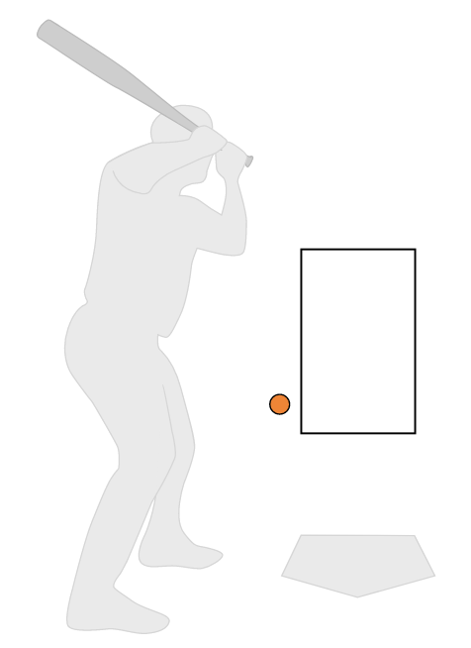
Hoberg Call 4
Strike 3,should have been ball 4
Weight importance rank: 2nd
Change in run expectancy: -0.489
Mean Simulated Scores:
San Francisco: 3.7779
Atlanta: 1.5221
Most Common Final Score:
San Francisco 3-1 (51.6% of simulations)
San Francisco scores in 33.8% of simulations
SFG scores more than one run in 22.6% of simulations
Win probability with correct call:
San Francisco: 93.44%
Notes:
Calvin

Slide 26
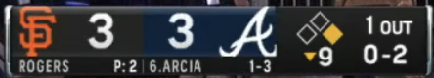
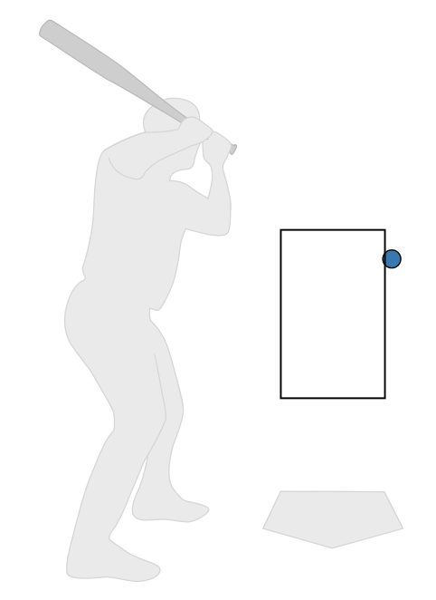
Hoberg Call 5
Ball 1, should have been strike 3
Weight importance rank: 5th
Change in run expectancy: +0.030
Mean Simulated Scores:
San Francisco: 4.3609
Atlanta: 4.2805
Most Common Final Scores:
Atlanta 4-3 (28.3% of simulations)
San Francisco 4-3 (13.9% of simulations)
Atlanta 5-4 (10.4% of simulations)
Win probability with correct call:
Atlanta: 56.17%
Notes:
Calvin

Slide 27
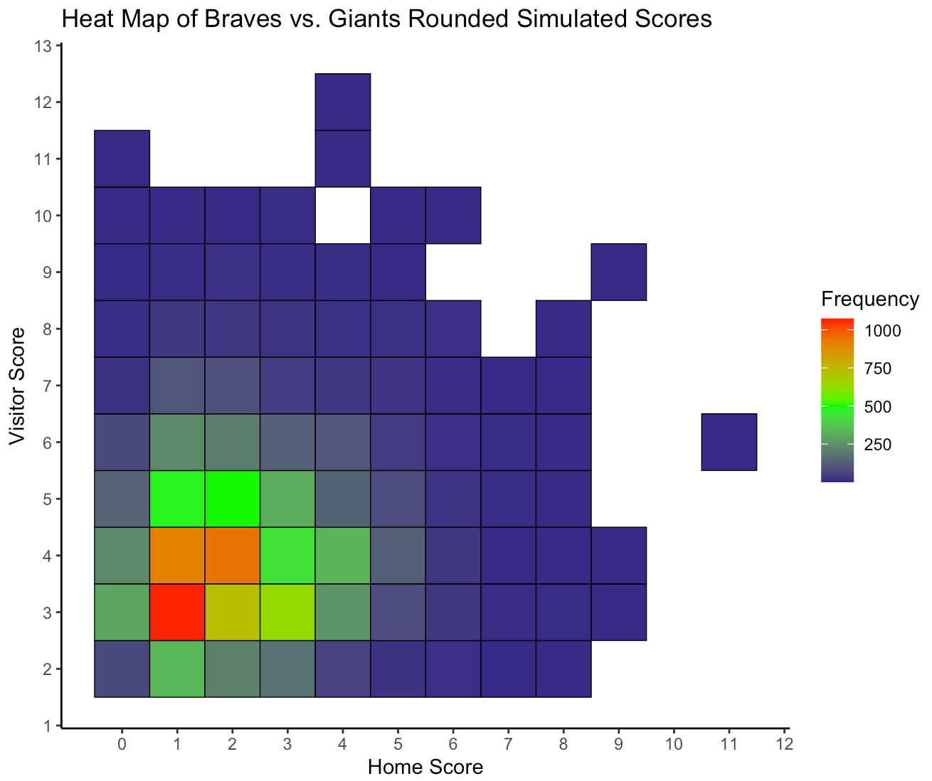
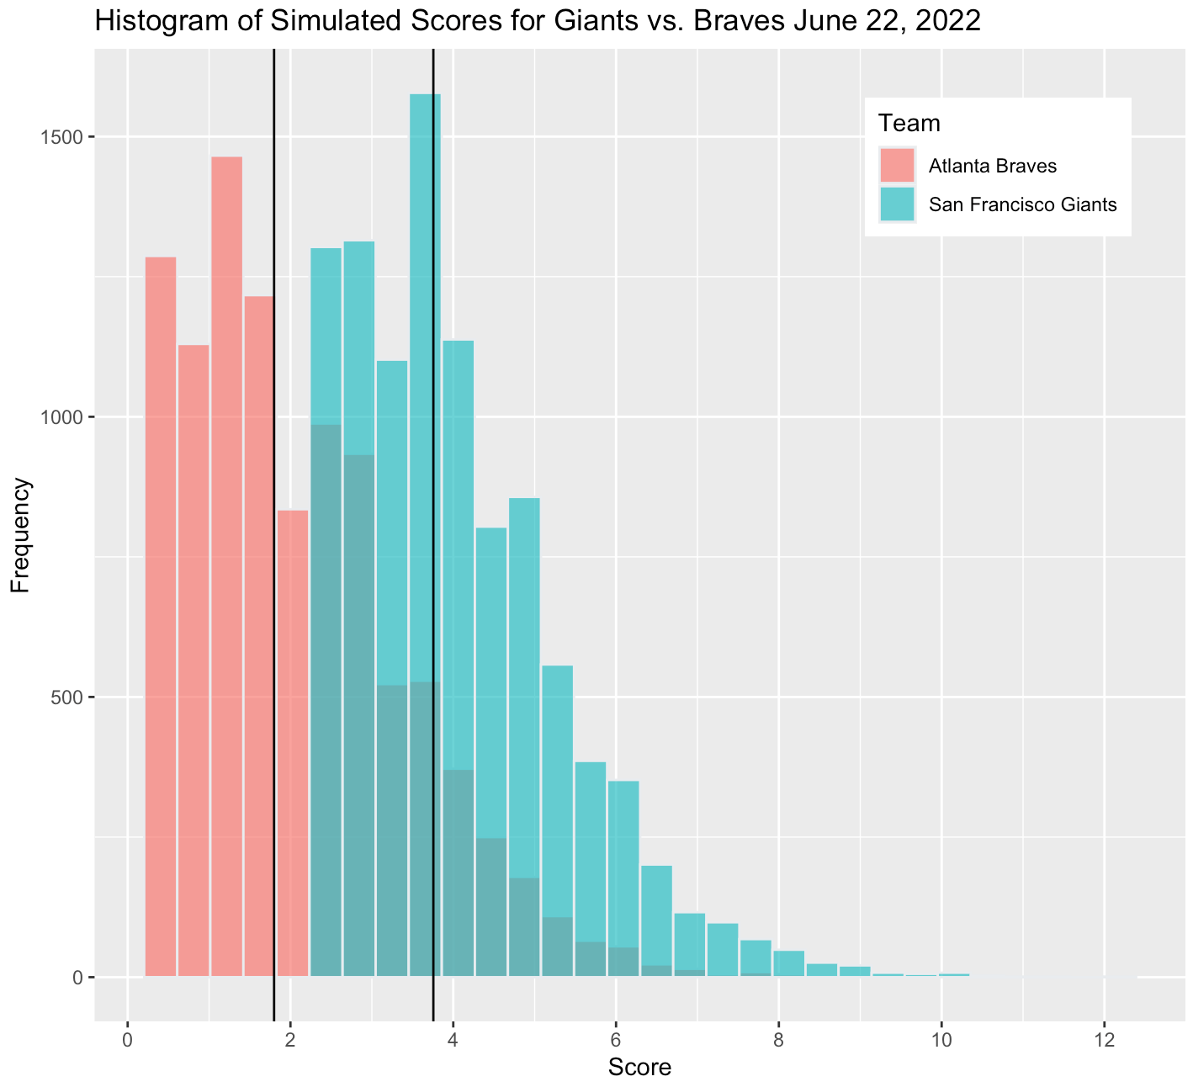
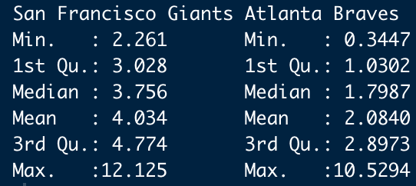
Hoberg Results
Notes:
Calvin

Slide 28
Comparisons
Similarities
Missed calls changed our projected outcomes of both games and had a large impact in final score
Weighting system changes pitch importance vs. Ump Scorecards
Missed calls ended high likelihood scoring opportunities (Eddings call 19, Hoberg call 4)
Differences
Eddings game has more scores to average, leading to less variability
Eddings game goes into extra innings
Eddings game had 5x more calls
Notes:
Calvin

Slide 29
Section 5: Summary and Analysis

Slide 30
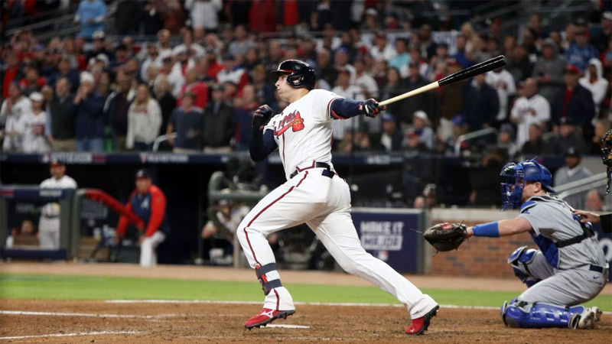
Limitations and Risks
Model doesn’t account for intentional walks, auto-balls, and auto-strikes
Threw out innings with walk-offs
Assumption of equal ability between teams and players
Disregards 2-strike foul balls
Weighted model can produce tied rounded scores
Notes:
doesn’t factor in in game strategy decisions, like if a pitcher decides to walk a batter
walk off: home time takes the lead in the bottom of the 9th so we don’t play the last inning

Slide 31

Next Steps
Create team or player specific matrices
Assess the probability of reaching certain states
Extend model to a 2nd or 3rd order Markov Chain
Live Betting Applications

Slide 32
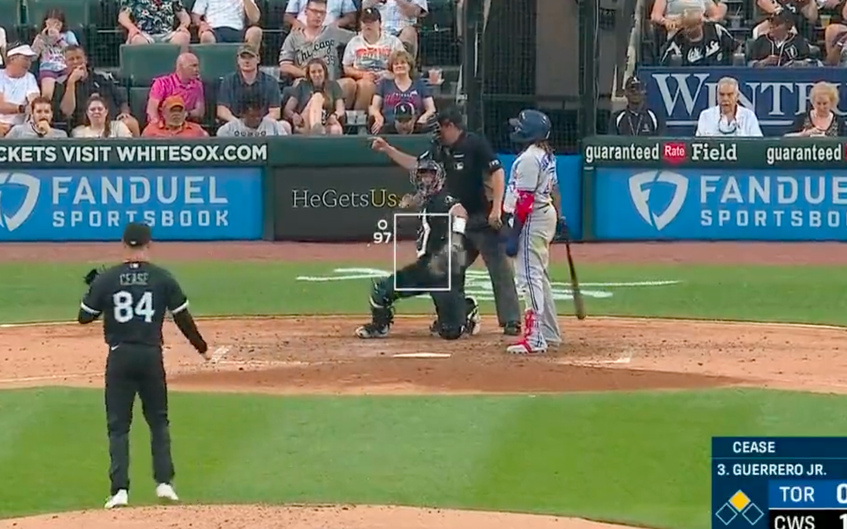
Summary
Simulated the outcome of a game by moving through transition probabilities
Outputs are runs scored based on a Markov chain
Ran both the Hoberg and Eddings game using weighted model
Transition probabilities generate expected score
Model Usage:
Predict how opposing teams match up
In-game strategy decisions
Calculate influence of certain plays
Notes:
a ball called a strike on a full count with 2 outs is a lot more influential than if theres no outs or the count is 0

Slide 33
Notes:
blank slide for questions (can also put title slide here once it is finished)

